Slide 1
463.1
Introduction
Computer Security II
CS463/ECE424
University of Illinois
Notes:
Based on slides by Nikita Borisov and Carl A. Gunter

Slide 2
Computer Security Introduction
Overview of two broad areas of past, current, and emerging interest
  Host Security
  Critical Infrastructure Protection

Slide 3
463.1.1
Host Security

Slide 4
History
Classical security work focused on multi-user, military and commercial systems
  Not applied to desktop computers
Early designs of desktop OS systems (which we are calling “hosts” for this discussion) included no security
  Single user
  Single address space
  No permissions

Slide 5
Early Threats
Viruses
  Boot sector viruses (trading floppies)
  Executable viruses (trading software)
Defenses
  Anti-virus software (e.g. Symantec)
  Software hygiene - beware of shareware
Mostly contained the problem

Slide 6
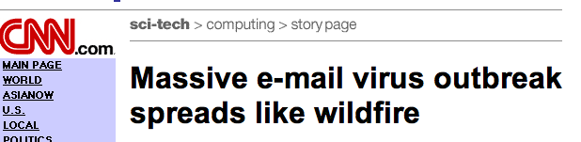
Big Change 1: Internet
Constant data exchange (email, web)
Active attacks are possible
Time to spread a virus / worm much faster
  Email virus spreads in days / hours
  Active worm can spread in minutes / seconds
Anti-virus software not enough

Slide 7
Attacks using the Internet
Mar 1999 Melissa virus
  Word macro that used address books
  Infected 1.2 million machines and cost $80M
Feb 2000 DoS attack
  Shut down Yahoo, Amazon, E*Trade, eBay, CNN.com
  Yahoo costs estimated at $116K
May 2000 ILOVEYOU worm
  Attribution: a rare instance where the perpetrator, a security PhD student in the Philippines, was found.
  However, there were no laws there against building and releasing viruses!
[HennessyPL03]
Notes:
[HennessyPL03] Information Technology for Counterterrorism Immediate Actions and Future Possibilities,
John L. Hennessy, David A. Patterson, and Herbert Lin, Editors. Computer Science and Telecommunications Board, National Research Council, 2003.
http://www.nap.edu/openbook.php?isbn=0309087368
Melissa: http://www.cert.org/advisories/CA-1999-04.html
Code Red: http://www.f-secure.com/v-descs/bady.shtml
Nimda : http://www.f-secure.com/v-descs/nimda.shtml
Summary
Melissa is a Word macro exploit that uses the address book of the victim to propagate. This strategy supported social engineering since messages could be made to seem as if they came from trusted contacts by taking pairs of contacts from a compromised source.
ILOVEYOU is a worm spread by email using the subject header “I Love You”. This involved explicit social engineering, which was very effective at the time.
Code Red is an IIS exploit that launches a DoS attack on www1.whitehouse.gov. There was a concern that a broad portion of the Internet could be affected, not just the target site.
Nimda (admin spelled backwards) was similar to Code Red but added some new propagation strategies like using existing web sites to offer infected files and end user machines to scan for vulnerable sites
Here is an excerpt from [HennessyPL03]:
In March 1999, the Melissa virus infected e-mail systems worldwide. According to estimates from federal officials, the virus caused $80 million in disruption, lost commerce, and computer downtime, and infected 1.2 million computers. The virus launched when a user opened an infected Microsoft Word 8 or Word 9 document contained in either Office 97 or Office 2000. The virus, programmed as a macro in the Word document, prompted the Outlook e-mail program to send the infected document to the first 50 addresses in the victim’s Outlook address book. When a recipient opened the attachment in the e-mail, which appeared to be from a friend, co-worker, boss or family member, the virus spread to the first 50 e-mail addresses in that person’s address book, and thus continued to propagate. Six months after the first appearance of Melissa, variant strains continued to make their way into users’ inboxes despite warnings and widespread publicity about opening attachments while the macro function is enabled.
Over a four-day period beginning February 7, 2000, distributed denial-of-service attacks temporarily shut down Yahoo, Amazon, E*Trade, eBay, CNN.com, and other Web sites. Yahoo shut down its site for several hours during peak viewing hours at an estimated cost of $116,000. While the companies behind the targeted Web sites said that the attacks themselves would have minor financial impact, the attacks were of such importance that the White House convened a group of computer-security experts and technology executives to discuss the Internet’s vulnerabilities. Federal officials spent millions in investigations of the DDOS attacks that garnered significant public attention.
'I Love You' Virus Turns Ten: What Have We Learned? Larry Seltzer. PC April 28, 2010. http://www.pcmag.com/article2/0,2817,2363172,00.asp
The author of the worm, Onel de Guzman of the Philippines, was arrested with a co-conspirator, Reomel Ramones. The two were released when the authorities realized there were no laws in the Philippines against writing malware. De Guzman had been forced to drop out of a University because his thesis, a proposal for commercializing a password-stealing trojan horse, was rejected by the faculty.

Slide 8
Blended Attacks Using the Web
Jul 2001 Code Red (White House DoS) and Sep 2001 Nimda
  Code Red infected 359K computers in less than 14 hours
  Estimated $3B lost world-wide because of these two worms
Welcome to http://www.worm.com
Hacked by Chinese!
[HennessyPL03]
Notes:
On July 19, 2001, the Code Red program “worm” infected more than 359,000 computers in less than 14 hours and 2,000 new infections per minute occurred during the height of its attack.
Nimda, a similar hostile program first appearing on September 18, 2001, was potentially more damaging because it combined successful features of previous viruses such as Melissa and ILOVEYOU. During the first 24 hours, Nimda spread through e-mail, corporate networks, and Web browsers, infecting as many as 150,000 Web server and personal computers (PCs) in the United States.
The virus—“admin” spelled backwards—was designed to affect PCs and servers running the Windows operating system and to resend itself every 10 days unless it was deleted. Nimda reproduced itself both via e-mail and over the Web— a user could be victimized by merely browsing a Web site that was infected. Furthermore, the infected machines sent out a steady stream of probes looking for new systems to attack. The additional traffic could effectively shut down company networks and Web sites; Nimda-generated traffic did not slow down the Internet overall, but infected companies reported serious internal slowdowns.
Code Red and Nimda are examples of these new blended threats. Both are estimated to have caused $3 billion worldwide in lost productivity and for testing, cleaning, and deploying patches to computer systems.
1 Ann Harrison. 1999. “FAQ: The Melissa Virus,” COMPUTERWORLD, March 31. Available online at <http://www.computerworld.com/news/1999/story/0,11280,27617,00.html>.2 Ross Kerber. 2000. “Vandal Arrests Would Only Be the Beginning Penalties, Damages Seen Hard to Determine,” The Boston Globe , February 11.3 Henry Norr. 2001. “New Worm Plagues Systems Worldwide,” The San Francisco Chronicle, September 19.4 Gregory Hulme. 2002. “One Step Ahead—Security Managers Are Trying to Be Prepared for the Next Blended Threat Attack,” InformationWeek , May 20.

Slide 9
Big Change 2: Complexity
Data files becoming more complex
Boundary between data & executable blurred
  JavaScript, Java, Active/X
  Word macros, PDF, …
Data hygiene not as easy

Slide 10
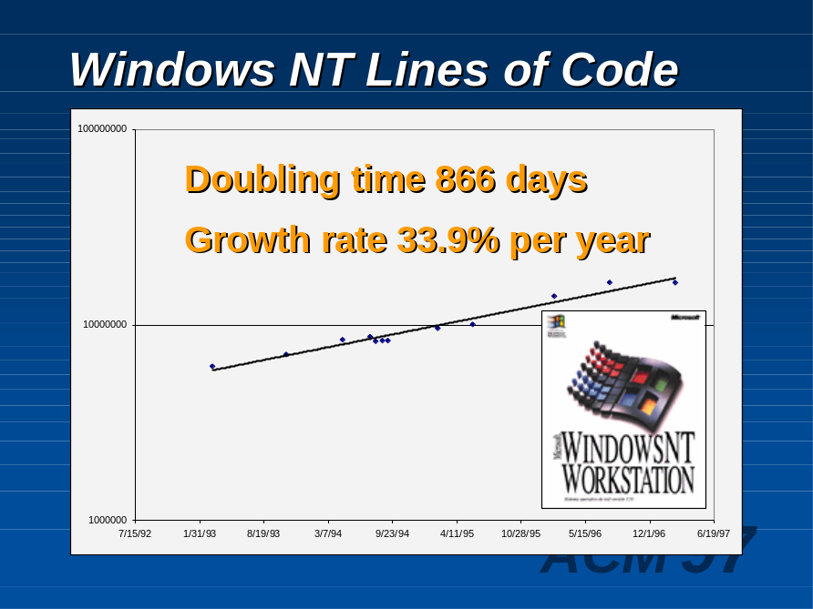
Software Vulnerabilities
Always have been present
But now can be exploited with data from the Internet
  Bugs in JPEG, ZLIB, MIME
Number of vulnerabilities increasing

Slide 11
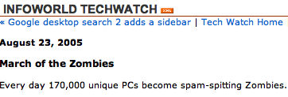
Big Change 3: Motivation
Attacks on hosts used to have little value
  A virus got you fame, glory (& perhaps prosecution)
  Serious attackers looked at commercial or military systems
New motivations
  Financial data: access to bank accounts, stock portfolios, …
  Spam: use machine as a zombie to send email

Slide 12

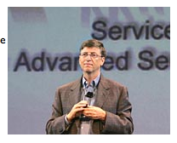


Consequences
Computer security on desktop big problem
  Unpatched system compromised in 5min - 2 hours
  Security lifted to highest priority by Microsoft, others
Notes:
The Gates keynote was in Feb 2005. Problems with attacks are not quickly solved as the August 2005 headline shows.

Slide 13
Transition in Security Paradigms
Old security paradigms moving to desktop
  Protection domains and access control
  Host-based intrusion detection
  Formal verification and program security
  Confinement

Slide 14
Software Update
Stem the flow of worms / viruses
  Upgrade software to address vulnerabilities
Many systems unpatched
  Some organizations delay patches
  Unmanaged PCs may be patched infrequently
Automated updates
  Trustworthiness of update source
  Non-disruptive patches

Slide 15
Zero-day Exploits
Worms that exploit previously unknown vulnerabilities
  Potentially disastrous results
Identify unknown worms
  Scanning detection
  Honeypots
Address with automated signature generation
Recovery strategies essential

Slide 16
Human Factors
Users specify security policy
  Difference between a secure and insecure action is user intent
Users can only make good decisions about something they understand
Research in security turning to HCI: Humans are the last (and often weakest) link

Slide 17


Slide 18
463.1.2
Critical Infrastructure Protection

Slide 19
Examples of Systems
Transportation
Financial
Energy
Human health
Agricultural health
Communication
Cities and fixed infrastructure
Notes:
This list is broadly based on the NRC report. Another list appears in NCIP 04:
• Agriculture and Food
• Water
• Public Health and Healthcare
• Emergency Services
• Defense Industrial Base
• Information Technology
• Telecommunications
• Energy
• Transportation Systems
• Banking and Finance
• Chemical
• Postal and Shipping
• National Monuments and Icons
• Dams
• Government Facilities
• Commercial Facilities
• Nuclear Reactors, Materials, and
Waste

Slide 20
PDD 63 Critical Infrastructure Protection
Bill Clinton, May 22, 1998
Critical infrastructures are those physical and cyber-based systems essential to the minimum operations of the economy and government. They include, but are not limited to, telecommunications, energy, banking and finance, transportation, water systems and emergency services, both governmental and private.
Many of the nation's critical infrastructures have historically been physically and logically separate systems that had little interdependence. As a result of advances in information technology and the necessity of improved efficiency, however, these infrastructures have become increasingly automated and interlinked.
These same advances have created new vulnerabilities to equipment failure, human error, weather and other natural causes, and physical and cyber attacks. Addressing these vulnerabilities will necessarily require flexible, evolutionary approaches that span both the public and private sectors, and protect both domestic and international security.
Notes:
Presidential Decision Directive 63
http://www.fas.org/irp/offdocs/pdd/pdd-63.htm

Slide 21
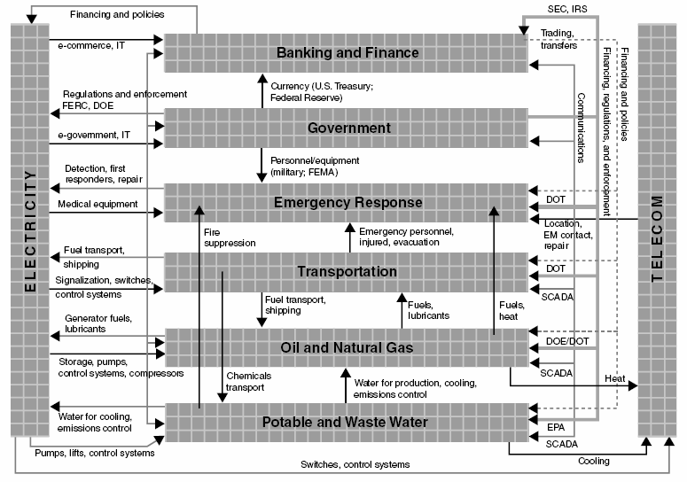
Interdependency of Systems
[NRC 02]
Notes:
[NRC02] Making the Nation Safer: The Role of Science and Technology in Countering Terrorism, Committee on Science and Technology for Countering Terrorism, National Research Council. National Research Council, 2002.
http://www.nap.edu/openbook.php?isbn=0309084814

Slide 22
For Want of a Nail
For want of a nail the shoe was lost.
For want of a shoe the horse was lost.
For want of a horse the rider was lost.
For want of a rider the battle was lost.
For want of a battle the kingdom was lost.
And all for the want of a horseshoe nail.

Slide 23
Case Study: 2003 Blackout
Provides an excellent example of failure of a critical infrastructure system involving computer control
Not caused by a malicious attack but influential in advancing concerns about cyber security for critical infrastructure

Slide 24
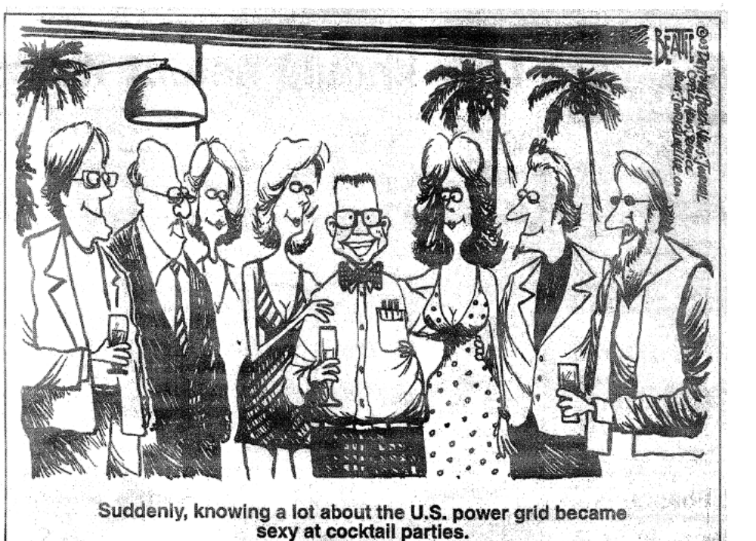
Power Engineering is Cool Again

Slide 25
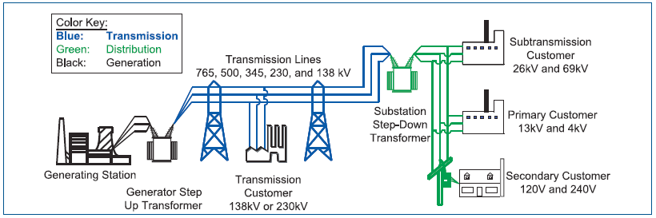
Basic Structure of the Electric Grid

Slide 26
Objectives of an Energy Management System (EMS)
Balance generation and demand
Maintain scheduled voltages
Ensure that thermal limits are not exceeded
Plan, design, and maintain the system to operate reliably
Keep the system in a stable condition
Prepare for emergencies
  Maintain the “N-1 criterion”
Notes:
Balance power generation and demand continuously
Balance reactive power supply and demand to maintain scheduled voltages
Monitor flows over transmission lines and other facilities to ensure that thermal (heating) limits are not exceeded
Keep the system in a stable condition
Operate the system so that it remains in a reliable condition even if a contingency occurs, such as the loss of a key generator or transmission facility (the “N-1 criterion”)
Plan, design, and maintain the system to operate reliably
Prepare for emergencies

Slide 27
SCADA for EMS
EMSs are increasingly exploiting computers and data networking
Supervisory Control and Data-Acquisition (SCADA):
  Data acquisition: collection, processing, monitoring
  Supervisory control: manual overrides, alarm inhibit/enable
  Alarm display and control
Notes:
Data collection is responsible for periodically acquiring data from remote terminal units at the
appropriate rate. In addition, data collection monitors the various scans to make sure they initiate
and complete within the current time period.
Data processing is responsible for converting analog values from raw data to engineering units.
It is also responsible for converting digital status points to a system convention of device states
(0 for closed and 1 for open). Data for points which are manually replaced in the database are not
usually processed. Data processing is also responsible for handling data obtained from data links to
other computer systems.

Slide 28
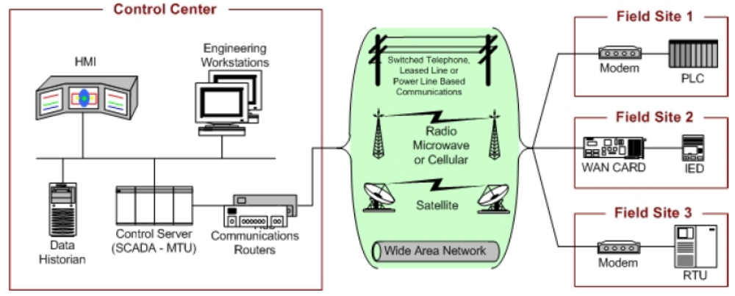
SCADA System General Layout
[StoufferFS08]
Notes:
[StoufferFS08] Guide to Industrial Control Systems (ICS) Security, Keith Stouffer, Joe Falco, and Karen Scarfone. NIST Special Publications 800-82, Final Public Draft 2008.
http://csrc.nist.gov/publications/drafts/800-82/draft_sp800-82-fpd.pdf

Slide 29
Documented Security Incidents for Industrial Control Systems
Salt River Project (1994): breach of a water and electricity provider’s computers by modem
Worchester Air Traffic Communications (1997): teenager disables public switching network for an airport
Maroochy Shire Sewage Spill (2000): disgruntled former employee accesses system releasing 264,000 gallons of raw sewage
Notes:
Salt River Project3. In 1994, the computer system of the Salt River Project (SRP), a major water and electricity provider in Phoenix, Arizona, was breached. The adversary accessed a computer or computers belonging to SRP via a dial-up modem on a backup computer.
Worcester Air Traffic Communications4. In March 1997, a teenager in Worcester, Massachusetts disabled part of the public switching network using a dial-up modem connected to the system. This knocked out phone service at the control tower, airport security, the airport fire department, the weather service, and carriers that use the airport. Also, the tower’s main radio transmitter and another transmitter that activates runway lights were shut down, as well as a printer that controllers use to monitor flight progress. The attack also knocked out phone service to 600 homes in the nearby town of Rutland.
Maroochy Shire Sewage Spill5. In the spring of 2000, a former employee of an Australian organization that develops manufacturing software applied for a job with the local government, but was rejected. Over a two-month period, the disgruntled rejected employee reportedly used a radio transmitter on as many as 46 occasions to remotely break into the controls of a sewage treatment system. He altered electronic data for particular sewerage pumping stations and caused malfunctions in their operations, ultimately releasing about 264,000 gallons of raw sewage into nearby rivers and parks.
Additional information on the Salt River Project incident can found at: http://news.com.com/2009-1001-954780.html and www.iti.uiuc.edu/events/2005_09_15_Jeff_Dagle.pdf
Additional information on the Worcester Air Traffic Communications incident can be found at: http://www.cnn.com/TECH/computing/9803/18/juvenile.hacker/index.html
Additional information on the Maroochy Shire Sewage Spill incident can be found at: http://www.theregister.co.uk/2001/10/31/hacker_jailed_for_revenge_sewage/ and www.iti.uiuc.edu/events/2005_09_15_Jeff_Dagle.pdf

Slide 30
Hypothetical Incident (1 of 2)
Using war dialers, an adversary finds modems connected to the programmable breakers of the electric power transmission control system, cracks the passwords that control access to the breakers, and changes the control settings to cause local power outages and damage equipment.
The adversary lowers the settings from 500 Ampere (A) to 200 A on some circuit breakers, taking those lines out of service and diverting power to neighboring lines.
The adversary also raises the settings on neighboring lines to 900 A, preventing the circuit breakers from tripping and overloading the lines.
This causes significant damage to transformers and other critical equipment, resulting in lengthy repair outages.
[Keeney KCMSR05]
Notes:
[KeeneyKCMSR05] Insider Threat Study: Computer System Sabotage in Critical Infrastructure Sectors, Michelle Keeney, Eileen Kowalski, Dawn Cappelli, Andrew Moore, Timothy Shimeall, Stephanie Rogers. United States Secret Service and Carnegie Mellon Software Institute, 2005,.

Slide 31
Hypothetical Incident (2 of 2)
A power plant serving a large metropolitan district has successfully isolated the control system from the corporate network of the plant, installed state-of-the-art firewalls, and implemented intrusion detection and prevention technology.
An engineer innocently downloads information on a continuing education seminar at a local college, inadvertently introducing a virus into the control network. Just before the morning peak, the operator screens go blank and the system is shut down.

Slide 32
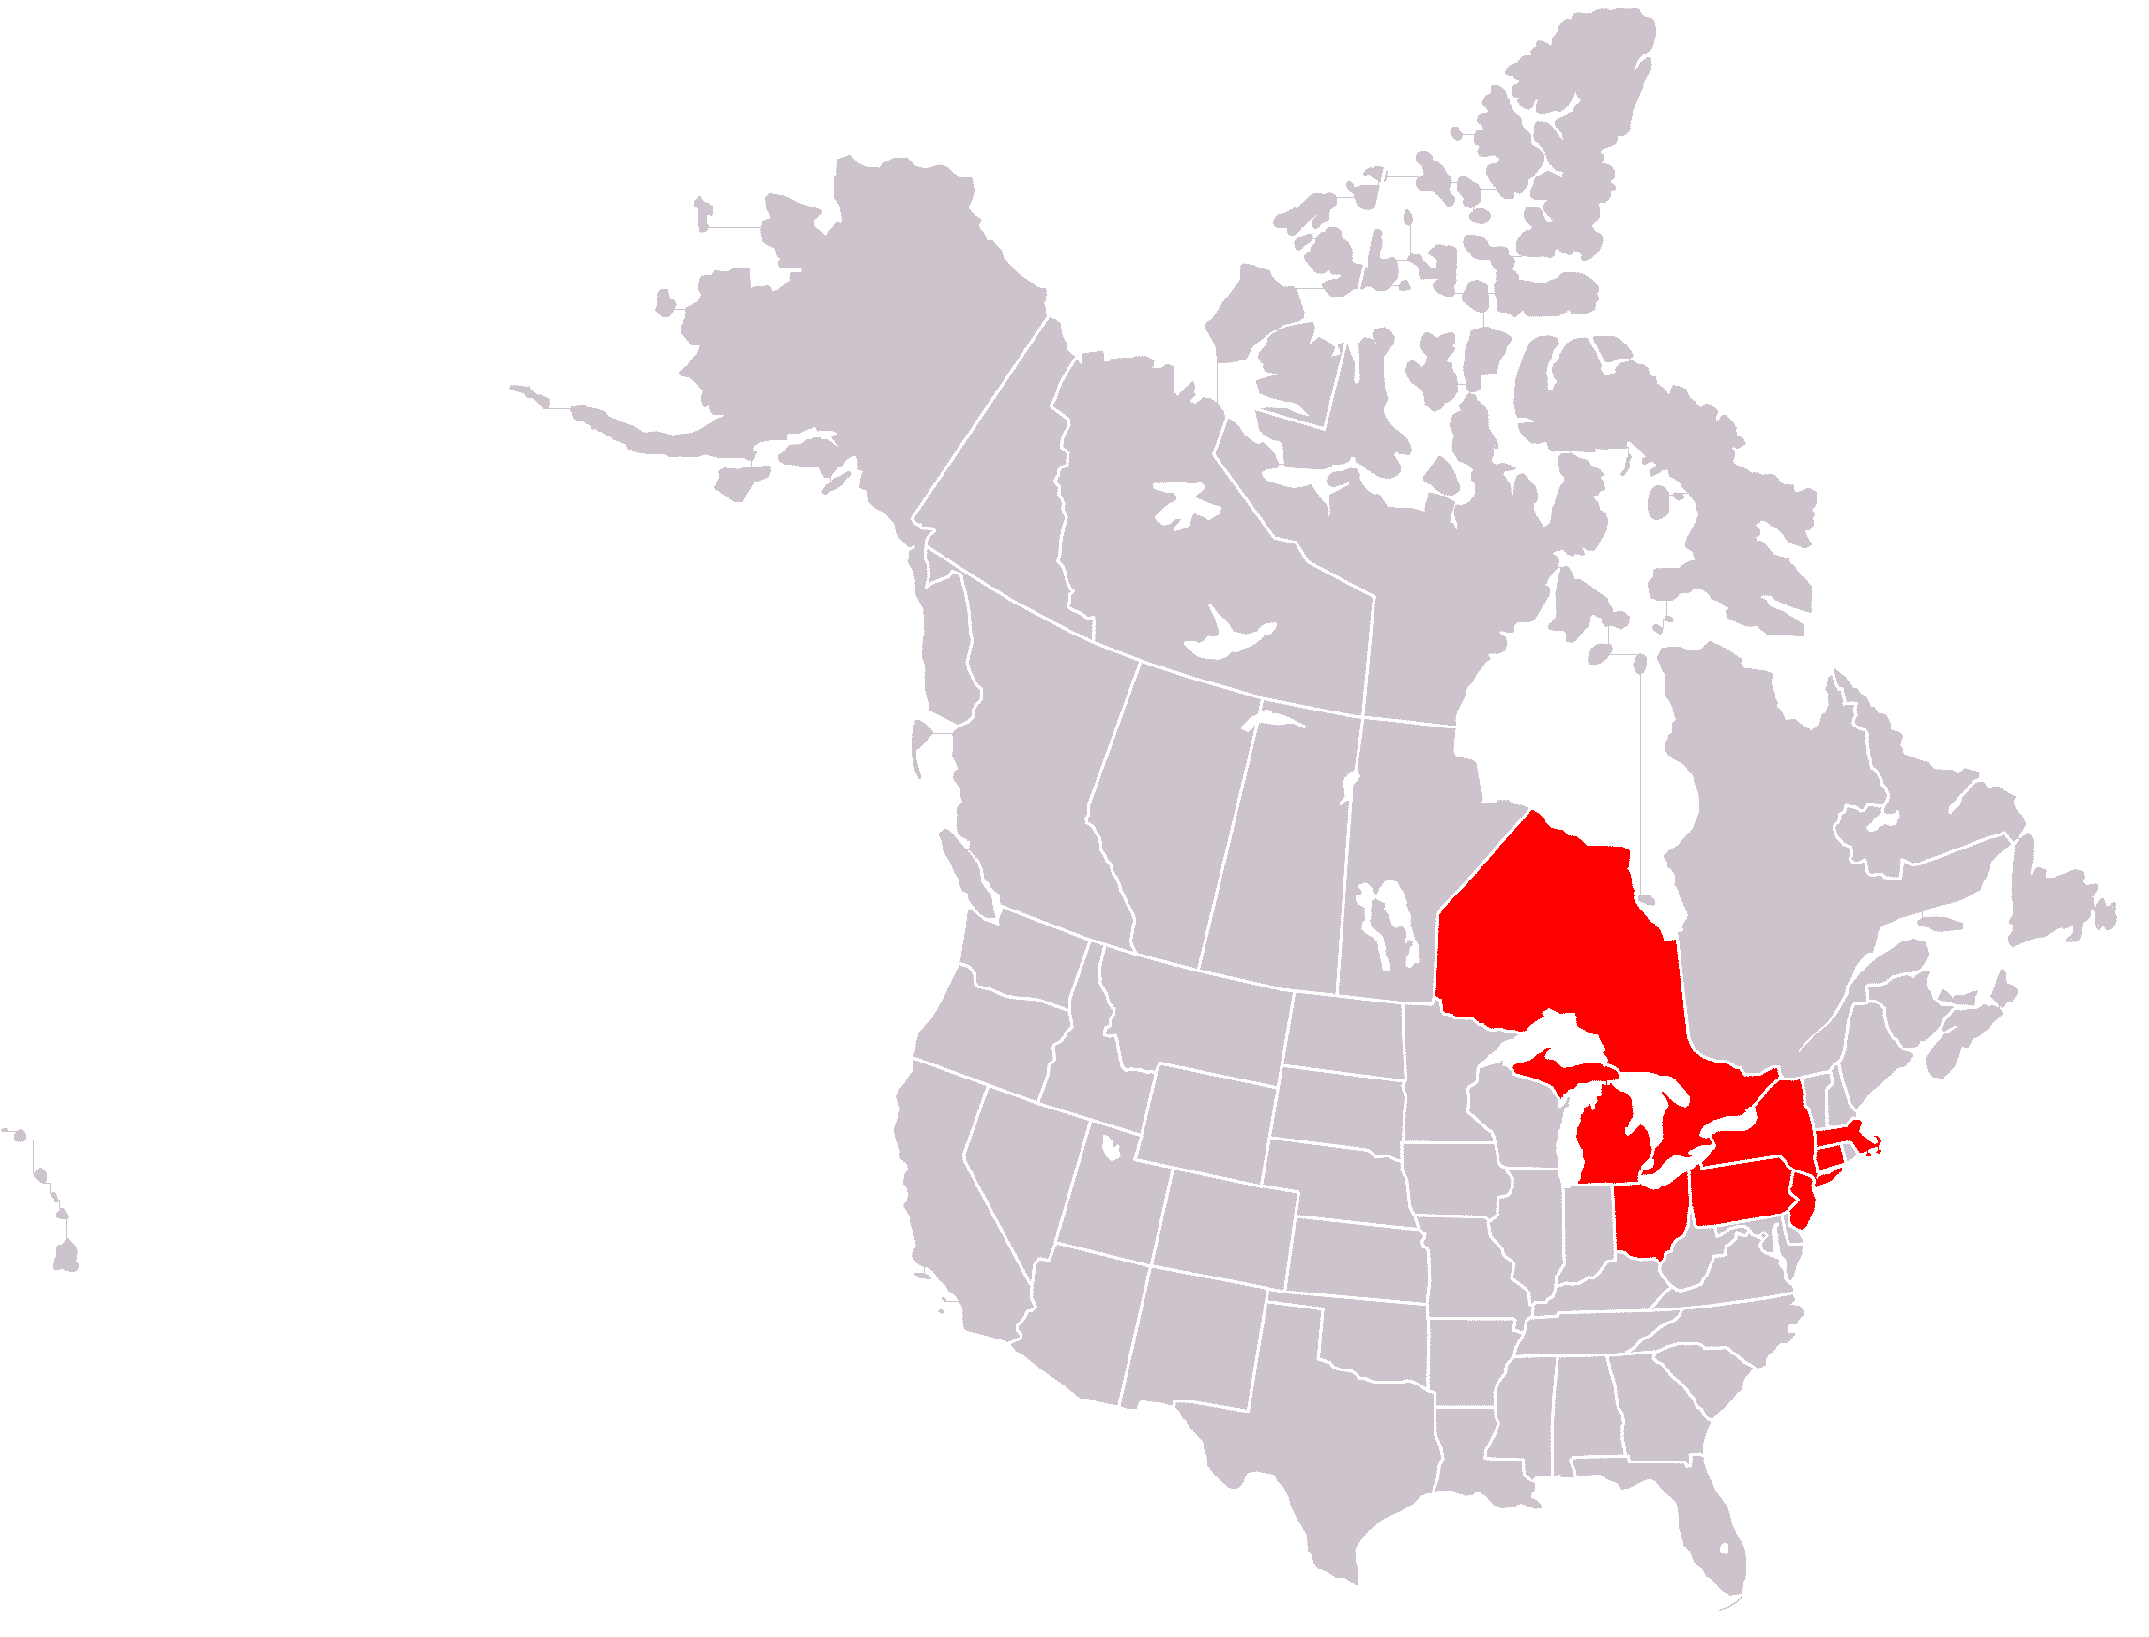
The 2003 Blackout
Started August 14 around 4pm and lasted about 4 days.
50 million people were affected.
Total costs were estimated at more than 5 billion US dollars.
Notes:
On August 14, 2003, large portions of the Midwest
and Northeast United States and Ontario, Canada,
experienced an electric power blackout. The outage
affected an area with an estimated 50 million
people and 61,800 megawatts (MW) of electric
load in the states of Ohio, Michigan, Pennsylvania,
New York, Vermont, Massachusetts, Connecticut,
New Jersey and the Canadian province of
Ontario. The blackout began a few minutes after
4:00 pm Eastern Daylight Time (16:00 EDT), and
power was not restored for 4 days in some parts of
the United States. Parts of Ontario suffered rolling
blackouts for more than a week before full power
was restored. Estimates of total costs in the United
States range between $4 billion and $10 billion
(U.S. dollars).1 In Canada, gross domestic product
was down 0.7% in August, there was a net loss of
18.9 million work hours, and manufacturing shipments
in Ontario were down $2.3 billion (Canadian
dollars).

Slide 33
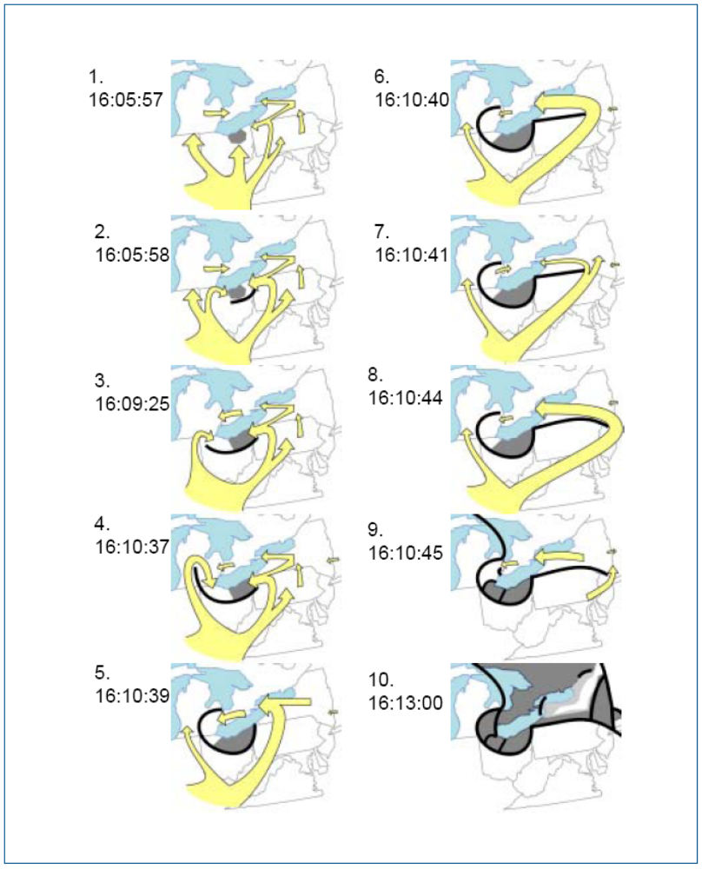
Cascading Failure
Phase 5: Unplanned shifts of power across the region
Phase 6: Full cascade
Phase 7: Formation of islands
Why the blackout stopped where it did
Notes:
On
August 14, relays on long lines such as the Homer
City-Watercure and the Homer City-Stolle Road
345-kV lines in Pennsylvania, that are not highly
integrated into the electrical network, tripped
quickly and split the grid between the sections
that blacked out and those that recovered without
further propagating the cascade.
The vast majority of trip operations on
lines along the blackout boundaries between PJM
and New York (for instance) show high-speed
relay targets which indicate that a massive power
surge caused each line to trip.
In the U.S. Midwest, as voltage levels declined
many generators in the affected area were operating
at maximum reactive power output before the
blackout. This left the system little slack to deal
with the low voltage conditions by ramping up
more generators to higher reactive power output
levels, so there was little room to absorb any system
“bumps” in voltage or frequency. In contrast,
in the northeast—particularly PJM, New York, and
ISO-New England—operators were anticipating
high power demands on the afternoon of August
14, and had already set up the system to maintain
higher voltage levels and therefore had more reactive
reserves on-line in anticipation of later afternoon
needs. Thus, when the voltage and
frequency swings began, these systems had reactive
power readily available to help buffer their
areas against potential voltage collapse without
widespread generation trips.

Slide 34
Root Causes
Causality can be described at multiple levels
  Management
  Technology
There is rarely a single cause for a major event
  “The vessel Baltic Star, registered in Panama, ran aground at full speed on the shore of an island in the Stockholm waters on account of thick fog.
  One of the boilers had broken down, the steering system reacted only slowly, the compass was maladjusted, the captain had gone down into the ship to telephone, the outlook man on the prow took a coffee break and the pilot had given an erroneous order in English to the sailor who was tending the rudder. The latter was hard of hearing and understood only Greek.”
Notes:
The quote is drawn from Nancy Leveson’s book Safeware on safety and computer control

Slide 35
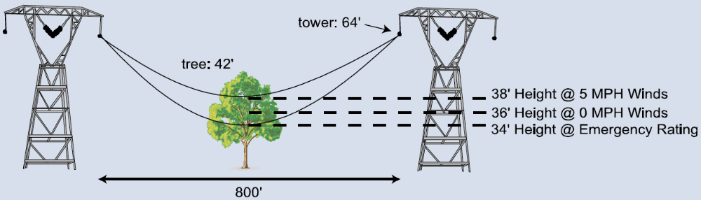
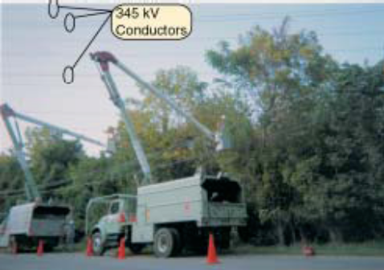
The Tree that Did $5,000,000,000 in Damage
All for the want of a horseshoe nail?
Notes:
This August 14 photo shows the tree that caused the loss of
the Hanna-Juniper line (tallest tree in photo). Other 345-kV
conductors and shield wires can be seen in the background.

Slide 36
What Caused the Blackout?
Limited electricity reserves and un-trimmed trees in the Cleveland control area
More failures than expected
Insufficient understanding of system state through networked computer control
  Multiple failed systems: delays from MISO state estimator and missed alarms at First Energy
System integration that enabled the blackout to spread broadly without supporting adequate information exchange

Slide 37
Effects on Other Infrastructure
Water supply
  Example: Cleveland lost water pressure and issued a boil advisory
Transportation
  Example: Amtrack NE Corridor down above Philadelphia
  Example: 7 hour wait for trucks because of loss of electronic border checks at the Canada/US border
Communication
  Wired telephones continued but cellar service was disrupted
Industry
  Many factory closings in affected area
Fixed infrastructure
  Looting in Ottowa and Brooklyn (but limited compared to the 1977 NY blackout)

Slide 38
Cyber-Security Dimension
The 2003 Blackout was influential for cyber-security.
Why? The report asserts that there is no evidence that a cyber-attack contributed to the blackout.
Yet, the computer control difficulties did contribute.
Increasing interdependency of the system and increased reliance on computer monitoring and control open the path to deliberately-caused failures like the 2003 blackout based on cyber-attacks.

Slide 40
Reading
[HennessyPL03] Information Technology for Counterterrorism Immediate Actions and Future Possibilities, John L. Hennessy, David A. Patterson, and Herbert Lin, Editors. Computer Science and Telecommunications Board, National Research Council, 2003. http://www.nap.edu/openbook.php?isbn=0309087368
[StoufferFS08] Guide to Industrial Control Systems (ICS) Security, Keith Stouffer, Joe Falco, and Karen Scarfone. NIST Special Publications 800-82, Final Public Draft 2008.
[Blackout04] Final Report on the August 14, 2003 Blackout in the United States and Canada: Causes and Recommendations, U.S.-Canada Power System Outage Task Force. 2004.
Notes:
http://seclab.uiuc.edu/docs/463%20Blackout%20Final%20Report.pdf

Slide 41
Discussion Questions
Host Security
Critical Infrastructure Protection
Will cloud computing provide greater security compared to computing on hosts?
Are smart phones more secure than hosts?
Are voting systems a critical infrastructure? What are their cyber threats and risks?

